Slide 1

Tests from outer space

Slide 2

About me
Максим Выпов
Java Developer
Пишу код и тесты

Slide 3
Agenda
Intro
BASICS
DATA DRIVEN
interactions
extensions
CONCLUSION

Slide 4

About Spock
CONFIDENTIAL | © 2019 EPAM Systems, Inc.

Slide 5
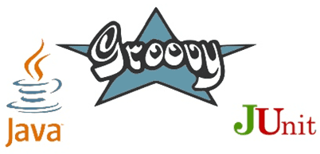
About Spock
Testing framework for Java and Groovy applications
Tests are written in Groovy
Based on junit runner Sputnik
CONFIDENTIAL | © 2019 EPAM Systems, Inc.

Slide 6

New framework?
CONFIDENTIAL | © 2019 EPAM Systems, Inc.

Slide 7

New framework?
CONFIDENTIAL | © 2019 EPAM Systems, Inc.

Slide 8
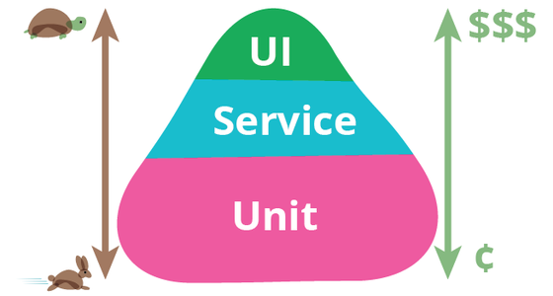
Disclaimer – watch your testing pyramid
CONFIDENTIAL | © 2019 EPAM Systems, Inc.

Slide 9
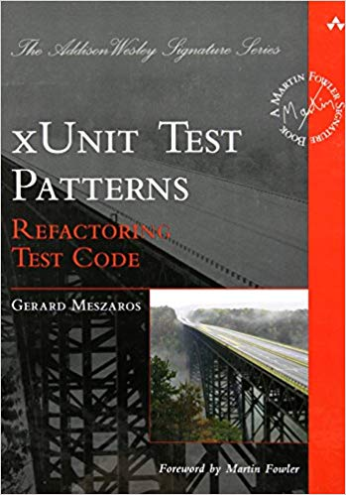
Disclaimer – watch your test code
CONFIDENTIAL | © 2019 EPAM Systems, Inc.

Slide 10
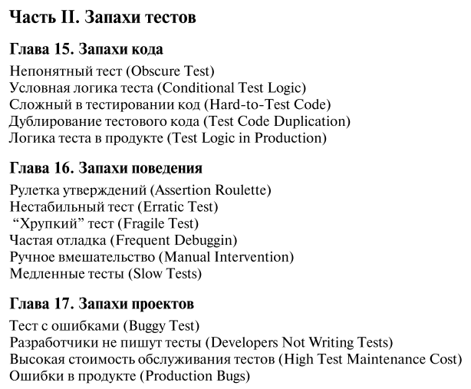
Disclaimer – watch your test code
CONFIDENTIAL | © 2019 EPAM Systems, Inc.

Slide 11
How to configure
<dependency> <groupId>org.spockframework</groupId> <artifactId>spock-core</artifactId> <version>${spock.version}</version> <scope>test</scope> </dependency> <dependency> <groupId>org.codehaus.groovy</groupId> <artifactId>groovy-all</artifactId> <version>${groovy.version}</version> <scope>test</scope> </dependency>
CONFIDENTIAL | © 2019 EPAM Systems, Inc.

Slide 12
How to configure
<build> <plugins> <plugin> <groupId>org.codehaus.gmavenplus</groupId> <artifactId>gmavenplus-plugin</artifactId> <version>${gmavenplus.version}</version> <executions> <execution> <goals> <goal>compile</goal> <goal>testCompile</goal> </goals> </execution> </executions> </plugin> </plugins> </build>
CONFIDENTIAL | © 2019 EPAM Systems, Inc.

Slide 13
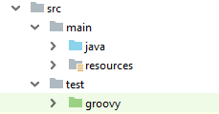
Project structure
CONFIDENTIAL | © 2019 EPAM Systems, Inc.

Slide 14
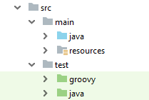
Project structure
CONFIDENTIAL | © 2019 EPAM Systems, Inc.

Slide 15
Terminology
Spock | JUnit
Specification | Test class
Feature | Test
Feature method | Test method
System Under Specification | System Under Test
CONFIDENTIAL | © 2019 EPAM Systems, Inc.

Slide 16
Specification
import spock.lang.Specification
class FirstSpecification extends Specification {
}
CONFIDENTIAL | © 2019 EPAM Systems, Inc.

Slide 17
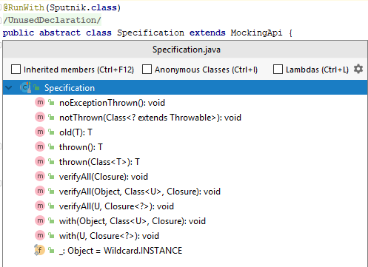
Specification base class
CONFIDENTIAL | © 2019 EPAM Systems, Inc.

Slide 18
Specification internals
class FirstSpecification extends Specification {
// fields
// fixture methods
// feature methods
// helper methods
}
CONFIDENTIAL | © 2019 EPAM Systems, Inc.

Slide 19
Fields
class FirstSpecification extends Specification {
def obj = new ClassUnderSpecification()
def coll = new Collaborator()
@Shared res = new VeryExpensiveResource()
}
CONFIDENTIAL | © 2019 EPAM Systems, Inc.

Slide 20


Fixture methods
def setupSpec() {}
def setup() {}
def cleanup() {}
def cleanupSpec() {}
@BeforeClass
@Before
@After
@AfterClass
CONFIDENTIAL | © 2019 EPAM Systems, Inc.

Slide 21
Feature method
class FirstSpecification extends Specification {
def "one plus one should equal two"() { expect: 1 + 1 == 2 }
}
CONFIDENTIAL | © 2019 EPAM Systems, Inc.

Slide 22
Blocks
AAA pattern
CONFIDENTIAL | © 2019 EPAM Systems, Inc.

Slide 23
Blocks
AAA pattern – TDD - Arrange Act Assert
CONFIDENTIAL | © 2019 EPAM Systems, Inc.

Slide 24

Blocks
AAA pattern – TDD - Arrange Act Assert
CONFIDENTIAL | © 2019 EPAM Systems, Inc.

Slide 25
Blocks
GWT – pattern
CONFIDENTIAL | © 2019 EPAM Systems, Inc.

Slide 26
Blocks
GWT – pattern BDD – Given When Then
CONFIDENTIAL | © 2019 EPAM Systems, Inc.

Slide 27

Blocks
GWT – pattern BDD – Given When Then
CONFIDENTIAL | © 2019 EPAM Systems, Inc.

Slide 28
Why do we need Blocks?
CONFIDENTIAL | © 2019 EPAM Systems, Inc.

Slide 29

Why do we need Blocks?
CONFIDENTIAL | © 2019 EPAM Systems, Inc.

Slide 30
Junit GWT blocks
@Test public void two_plus_two_should_equal_four() { // Given int left = 2; int right = 2; // When int result = left + right; // Then assertTrue(result == 4); }
CONFIDENTIAL | © 2019 EPAM Systems, Inc.

Slide 31
Junit GWT blocks Spock GWT blocks
@Test public void two_plus_two_should_equal_four() { // Given int left = 2; int right = 2; // When int result = left + right; // Then assertTrue(result == 4); }
def "two plus two should equal four"() { given: int left = 2 int right = 2 when: int result = left + right then: result == 4 }
CONFIDENTIAL | © 2019 EPAM Systems, Inc.

Slide 32
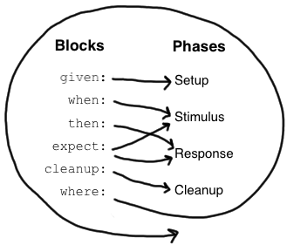
Blocks and phases
CONFIDENTIAL | © 2019 EPAM Systems, Inc.

Slide 33
Given is optional
given: def stack = new Stack() def elem = "push me"
CONFIDENTIAL | © 2019 EPAM Systems, Inc.

Slide 34
When and Then
given: int left = 2 int right = 2 when: int result = left + right then: result == 4
when: result = left - right then: result == 0
CONFIDENTIAL | © 2019 EPAM Systems, Inc.

Slide 35
Expect block
when: def result = 2 + 2 then: result == 4
CONFIDENTIAL | © 2019 EPAM Systems, Inc.

Slide 36
Expect block
when: def result = 2 + 2 then: result == 4
expect: 2 + 2 == 4
CONFIDENTIAL | © 2019 EPAM Systems, Inc.

Slide 37
Conditions
when: stack.push(elem) then:
!stack.isEmpty()
stack.size() == 1 stack.peek() == elem
CONFIDENTIAL | © 2019 EPAM Systems, Inc.

Slide 38
Conditions are implicit in then and expect blocks
when: stack.push(elem) then:
!stack.isEmpty()
stack.size() == 1 stack.peek() == elem
when: stack.push(elem) then:
assert !stack.isEmpty()
assert stack.size() == 1 assert stack.peek() == elem
CONFIDENTIAL | © 2019 EPAM Systems, Inc.

Slide 39
Explicit condition outside expect and then blocks
def setup() {
stack = new Stack() assert stack.empty }
CONFIDENTIAL | © 2019 EPAM Systems, Inc.

Slide 40
Power assert
def "Power assertions"() { expect: (4 * 15) - (24 / 3) == (20 * 3) - 9 }
CONFIDENTIAL | © 2019 EPAM Systems, Inc.

Slide 41
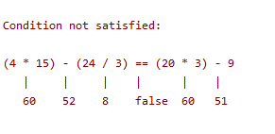
Power assert
def "Power assertions"() { expect: (4 * 15) - (24 / 3) == (20 * 3) - 9 }
CONFIDENTIAL | © 2019 EPAM Systems, Inc.

Slide 42
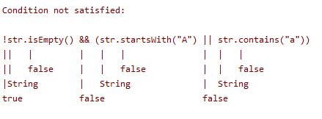
Power assert
def "Power assertions with string"() { expect: def str = "String" !str.isEmpty() && (str.startsWith("A") || str.contains("a")) }
CONFIDENTIAL | © 2019 EPAM Systems, Inc.

Slide 43
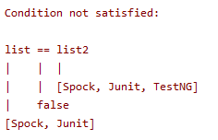
Power assert
def "Power assert with lists"() { expect: def list = ["Spock", "Junit"] def list2 = ["Spock", "Junit", "TestNG"] list == list2 }
CONFIDENTIAL | © 2019 EPAM Systems, Inc.

Slide 44
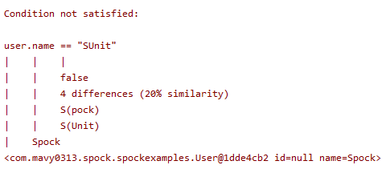
Power assert
def "Power assert with objects"() { expect: def user = new User("Spock") user.name == “SUnit" }
CONFIDENTIAL | © 2019 EPAM Systems, Inc.

Slide 45
Exception conditions
def "ArithmeticException is thrown"() { when: int result = 5 / 0 then: def ex = thrown(ArithmeticException) ex.getMessage() == "/ by zero" }
CONFIDENTIAL | © 2019 EPAM Systems, Inc.

Slide 46
Exception conditions
def "ArithmeticException is thrown"() { when: int result = 5 / 0 then: ArithmeticException ex = thrown() ex.getMessage() == "/ by zero" }
CONFIDENTIAL | © 2019 EPAM Systems, Inc.

Slide 47

Exception conditions
@Test(expected = ArithmeticException.class) public void ArithmeticExceptionIsThrown() { //when int result = 5 / 0; //then //exception is thrown }
def "ArithmeticException is thrown"() { when: int result = 5 / 0 then: ArithmeticException ex = thrown() ex.getMessage() == "/ by zero" }
CONFIDENTIAL | © 2019 EPAM Systems, Inc.

Slide 48
Exception conditions
@Rule public ExpectedException thrown = ExpectedException.none();
@Test public void ArithmeticExceptionIsThrownWithRule() { //given thrown.expect(ArithmeticException.class); thrown.expectMessage("/ by zero"); //when int result = 5 / 0; //then //exception is thrown }
def "ArithmeticException is thrown"() { when: int result = 5 / 0 then: ArithmeticException ex = thrown() ex.getMessage() == "/ by zero" }
CONFIDENTIAL | © 2019 EPAM Systems, Inc.

Slide 49
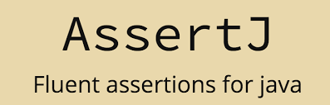
Exception conditions
@Test public void ArithmeticExceptionIsThrownWithAssertJ() { //when Throwable thrown = catchThrowable(() -> { int result = 5 / 0; }); //then assertThat(thrown)
.isInstanceOf(ArithmeticException.class) .hasMessage("/ by zero"); }
def "ArithmeticException is thrown"() { when: int result = 5 / 0 then: ArithmeticException ex = thrown() ex.getMessage() == "/ by zero" }
CONFIDENTIAL | © 2019 EPAM Systems, Inc.

Slide 50

Exception conditions
@Test public void ArithmeticExceptionIsThrownWithJunit5() { //when Exception ex = assertThrows(
ArithmeticException.class,
() -> { int result = 5 / 0;}); //then assertEquals("/ by zero", ex.getMessage()); }
def "ArithmeticException is thrown"() { when: int result = 5 / 0 then: ArithmeticException ex = thrown() ex.getMessage() == "/ by zero" }
CONFIDENTIAL | © 2019 EPAM Systems, Inc.

Slide 51
Exception conditions
@Test public void ArithmeticExceptionIsThrownWithJunit5() { //when Exception ex = assertThrows(
ArithmeticException.class,
() -> { int result = 5 / 0;}); //then assertEquals("/ by zero", ex.getMessage()); }
def "ArithmeticException is thrown"() { when: int result = 5 / 0 then: ArithmeticException ex = thrown() ex.getMessage() == "/ by zero" }
CONFIDENTIAL | © 2019 EPAM Systems, Inc.

Slide 52
Exception conditions
@Test public void ArithmeticExceptionIsThrownWithJunit5() { //when Exception ex = assertThrows(
ArithmeticException.class,
() -> { int result = 5 / 0;}); //then assertEquals("/ by zero", ex.getMessage()); }
def "ArithmeticException is thrown"() { when: int result = 5 / 0 then: ArithmeticException ex = thrown() ex.message == "/ by zero" }
CONFIDENTIAL | © 2019 EPAM Systems, Inc.

Slide 53

Exception conditions
@Test public void ArithmeticExceptionIsThrownWithJunit5() { //when Exception ex = assertThrows(
ArithmeticException.class,
() -> { int result = 5 / 0;}); //then assertEquals("/ by zero", ex.getMessage()); }
def "ArithmeticException is thrown"() { when: int result = 5 / 0 then: ArithmeticException ex = thrown() ex.message == "/ by zero" }
CONFIDENTIAL | © 2019 EPAM Systems, Inc.

Slide 54
Data Driven Testing
CONFIDENTIAL | © 2019 EPAM Systems, Inc.

Slide 55

Data Driven Testing
CONFIDENTIAL | © 2019 EPAM Systems, Inc.

Slide 56
Data Driven Testing
def "maximum of two numbers"() { expect: Math.max(1, 3) == 3 Math.max(7, 4) == 7 Math.max(0, 0) == 0 }
CONFIDENTIAL | © 2019 EPAM Systems, Inc.

Slide 57
Data Driven Testing
def "maximum of two numbers"() { expect: Math.max(1, 3) == 3 Math.max(7, 4) == 7 Math.max(0, 0) == 0 }
def "maximum of two numbers"(int a, int b, int c) { expect: Math.max(a, b) == c where: a | b | c 1 | 3 | 3 7 | 4 | 7 0 | 0 | 0 }
CONFIDENTIAL | © 2019 EPAM Systems, Inc.

Slide 58
Data Driven Testing
def "maximum of two numbers"() { expect: Math.max(1, 3) == 3 Math.max(7, 4) == 7 Math.max(0, 0) == 0 }
def "maximum of two numbers"(int a, int b, int c) { expect: Math.max(a, b) == c where: a | b | c 1 | 3 | 3 7 | 4 | 7 0 | 0 | 0 }
def "maximum of two numbers"() { expect: Math.max(a, b) == c where: a | b || c 1 | 3 || 3 7 | 4 || 7 0 | 0 || 0 }
CONFIDENTIAL | © 2019 EPAM Systems, Inc.

Slide 59
Data Driven Testing Failure report
def "maximum of two numbers"() { expect: Math.max(a, b) == c where: a | b || c 1 | 3 || 3 7 | 4 || 4 0 | 0 || 0 }
CONFIDENTIAL | © 2019 EPAM Systems, Inc.

Slide 60
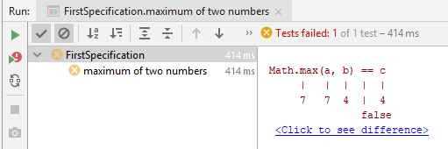
Data Driven Testing Failure report
def "maximum of two numbers"() { expect: Math.max(a, b) == c where: a | b || c 1 | 3 || 3 7 | 4 || 4 0 | 0 || 0 }
CONFIDENTIAL | © 2019 EPAM Systems, Inc.

Slide 61
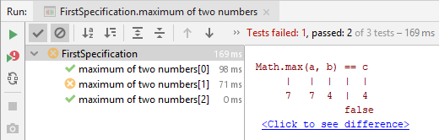
Data Driven Testing @Unroll
@Unroll
def "maximum of two numbers"() { expect: Math.max(a, b) == c where: a | b || c 1 | 3 || 3 7 | 4 || 4 0 | 0 || 0 }
CONFIDENTIAL | © 2019 EPAM Systems, Inc.

Slide 62
Data Driven Testing variables values
@Unroll
def "maximum of #a and #b is #c"() { expect: Math.max(a, b) == c where: a | b || c 1 | 3 || 3 7 | 4 || 4 0 | 0 || 0 }
CONFIDENTIAL | © 2019 EPAM Systems, Inc.

Slide 63
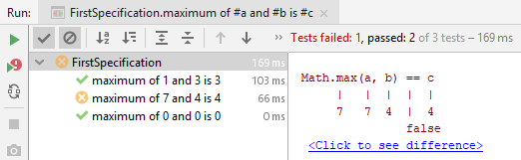
Data Driven Testing variables values
@Unroll
def "maximum of #a and #b is #c"() { expect: Math.max(a, b) == c where: a | b || c 1 | 3 || 3 7 | 4 || 4 0 | 0 || 0 }
CONFIDENTIAL | © 2019 EPAM Systems, Inc.

Slide 64
Parameterized test with Junit4
CONFIDENTIAL | © 2019 EPAM Systems, Inc.

Slide 65
Parameterized test with Junit4 System Under Test
public class Calculator { public int sum(int first, int second) { return first + second; } }
CONFIDENTIAL | © 2019 EPAM Systems, Inc.

Slide 66
Parameterized test with Junit4 add Parameterized runner
import org.junit.runner.RunWith; import org.junit.runners.Parameterized;
@RunWith(Parameterized.class) public class Junit4CalculatorTest {
}
CONFIDENTIAL | © 2019 EPAM Systems, Inc.

Slide 67
Parameterized test with Junit4 add @Parameters method
import java.util.Arrays; import java.util.Collection;
import org.junit.runner.RunWith; import org.junit.runners.Parameterized;
import org.junit.runners.Parameterized.Parameters;
@RunWith(Parameterized.class) public class Junit4CalculatorTest {
@Parameters public static Collection<Object[]> data() { return Arrays.asList(new Object[][] { { 0, 0, 0 }, { 1, 1, 2 } }); }
}
CONFIDENTIAL | © 2019 EPAM Systems, Inc.

Slide 68
Parameterized test with Junit4 add fields
import java.util.Arrays; import java.util.Collection;
import org.junit.runner.RunWith; import org.junit.runners.Parameterized;
import org.junit.runners.Parameterized.Parameters;
@RunWith(Parameterized.class) public class Junit4CalculatorTest {
private final int first; private final int second; private final int expectedSum;
@Parameters public static Collection<Object[]> data() { return Arrays.asList(new Object[][] { { 0, 0, 0 }, { 1, 1, 2 } }); }
}
CONFIDENTIAL | © 2019 EPAM Systems, Inc.

Slide 69
Parameterized test with Junit4 add constructor
import java.util.Arrays; import java.util.Collection;
import org.junit.runner.RunWith; import org.junit.runners.Parameterized;
import org.junit.runners.Parameterized.Parameters;
@RunWith(Parameterized.class) public class Junit4CalculatorTest {
private final int first; private final int second; private final int expectedSum;
@Parameters public static Collection<Object[]> data() { return Arrays.asList(new Object[][] { { 0, 0, 0 }, { 1, 1, 2 } }); }
public Junit4CalculatorTest(int first, int second, int expectedSum) { this.first = first; this.second = second; this.expectedSum = expectedSum; }
}
CONFIDENTIAL | © 2019 EPAM Systems, Inc.

Slide 70
Parameterized test with Junit4 add test
import static org.junit.Assert.assertEquals;
import java.util.Arrays; import java.util.Collection;
import org.junit.Test;
import org.junit.runner.RunWith; import org.junit.runners.Parameterized;
import org.junit.runners.Parameterized.Parameters;
@RunWith(Parameterized.class) public class Junit4CalculatorTest {
private final int first; private final int second; private final int expectedSum;
@Parameters public static Collection<Object[]> data() { return Arrays.asList(new Object[][] { { 0, 0, 0 }, { 1, 1, 2 } }); }
public Junit4CalculatorTest(int first, int second, int expectedSum) { this.first = first; this.second = second; this.expectedSum = expectedSum; }
@Test public void shouldReturnCorrectSum() { // given Calculator calculator = new Calculator(); // when int actualSum = calculator.sum(first, second); // then assertEquals(expectedSum, actualSum); }
}
CONFIDENTIAL | © 2019 EPAM Systems, Inc.

Slide 71

Parameterized test with Junit4 add test
import static org.junit.Assert.assertEquals;
import java.util.Arrays; import java.util.Collection;
import org.junit.Test;
import org.junit.runner.RunWith; import org.junit.runners.Parameterized;
import org.junit.runners.Parameterized.Parameters;
@RunWith(Parameterized.class) public class Junit4CalculatorTest {
private final int first; private final int second; private final int expectedSum;
@Parameters public static Collection<Object[]> data() { return Arrays.asList(new Object[][] { { 0, 0, 0 }, { 1, 1, 2 } }); }
public Junit4CalculatorTest(int first, int second, int expectedSum) { this.first = first; this.second = second; this.expectedSum = expectedSum; }
@Test public void shouldReturnCorrectSum() { // given Calculator calculator = new Calculator(); // when int actualSum = calculator.sum(first, second); // then assertEquals(expectedSum, actualSum); }
}
CONFIDENTIAL | © 2019 EPAM Systems, Inc.

Slide 72

Parameterized test with Junit4 and JUnitParams
CONFIDENTIAL | © 2019 EPAM Systems, Inc.

Slide 73
Parameterized test with Junit4 and JUnitParams
Parameterised tests that don't suck
CONFIDENTIAL | © 2019 EPAM Systems, Inc.

Slide 74
Parameterized test with Junit4 and JUnitParams
<dependency> <groupId>pl.pragmatists</groupId> <artifactId>JUnitParams</artifactId> <version>${junitparams.version}</version> <scope>test</scope> </dependency>
CONFIDENTIAL | © 2019 EPAM Systems, Inc.

Slide 75
Parameterized test with Junit4 and JUnitParams
@RunWith(JUnitParamsRunner.class) public class JunitParamsCalculatorTest { @Test @Parameters({ "0, 0, 0", "1, 1, 2" }) public void shouldReturnCorrectSum(int first, int second, int expectedSum) { // given Calculator calculator = new Calculator(); // when int actualSum = calculator.sum(first, second); // then assertEquals(expectedSum, actualSum); } }
CONFIDENTIAL | © 2019 EPAM Systems, Inc.

Slide 76
Parameterized test with Junit4 and JUnitParams
@RunWith(JUnitParamsRunner.class) public class JunitParamsCalculatorTest { @Test @Parameters({ "0, 0, 0", "1, 1, 2" }) public void shouldReturnCorrectSum(int first, int second, int expectedSum) { // given Calculator calculator = new Calculator(); // when int actualSum = calculator.sum(first, second); // then assertEquals(expectedSum, actualSum); } }
CONFIDENTIAL | © 2019 EPAM Systems, Inc.

Slide 77
Parameterized test with Junit4 and JUnitParams
@RunWith(JUnitParamsRunner.class) public class JunitParamsCalculatorTest { @Test @Parameters({ "0, 0, 0", "1, 1, 2" }) public void shouldReturnCorrectSum(int first, int second, int expectedSum) { // given Calculator calculator = new Calculator(); // when int actualSum = calculator.sum(first, second); // then assertEquals(expectedSum, actualSum); } }
CONFIDENTIAL | © 2019 EPAM Systems, Inc.

Slide 78
Parameterized test with Junit4 and JUnitParams
@RunWith(JUnitParamsRunner.class) public class JunitParamsCalculatorTest { @Test @Parameters({ "0, 0, 0", "1, 1, 2" }) public void shouldReturnCorrectSum(int first, int second, int expectedSum) { // given Calculator calculator = new Calculator(); // when int actualSum = calculator.sum(first, second); // then assertEquals(expectedSum, actualSum); } }
CONFIDENTIAL | © 2019 EPAM Systems, Inc.

Slide 79
Parameterized test with Junit5
CONFIDENTIAL | © 2019 EPAM Systems, Inc.

Slide 80
Parameterized test with Junit5
<dependency> <groupId>org.junit.jupiter</groupId> <artifactId>junit-jupiter-params</artifactId> <version>${junit-jupiter.version}</version> <scope>test</scope> </dependency>
CONFIDENTIAL | © 2019 EPAM Systems, Inc.

Slide 81
Parameterized test with Junit5
public class Junit5CalculatorTest { @ParameterizedTest @CsvSource({ "0, 0, 0", "1, 1, 2" }) public void shouldReturnCorrectSum(int first, int second, int expectedSum) { // given Calculator calculator = new Calculator(); // when int actualSum = calculator.sum(first, second); // then assertEquals(expectedSum, actualSum); }
}
CONFIDENTIAL | © 2019 EPAM Systems, Inc.

Slide 82
Parameterized test with Junit5
public class Junit5CalculatorTest { @ParameterizedTest @CsvSource({ "0, 0, 0", "1, 1, 2" }) public void shouldReturnCorrectSum(int first, int second, int expectedSum) { // given Calculator calculator = new Calculator(); // when int actualSum = calculator.sum(first, second); // then assertEquals(expectedSum, actualSum); }
}
CONFIDENTIAL | © 2019 EPAM Systems, Inc.

Slide 83
Parameterized test with Junit5
public class Junit5CalculatorTest { @ParameterizedTest @CsvSource({ "0, 0, 0", "1, 1, 2" }) public void shouldReturnCorrectSum(int first, int second, int expectedSum) { // given Calculator calculator = new Calculator(); // when int actualSum = calculator.sum(first, second); // then assertEquals(expectedSum, actualSum); }
}
CONFIDENTIAL | © 2019 EPAM Systems, Inc.

Slide 84
Parameterized test with Junit5
public class Junit5CalculatorTest { @ParameterizedTest @CsvSource({ "0, 0, 0", "1, 1, 2" }) public void shouldReturnCorrectSum(int first, int second, int expectedSum) { // given Calculator calculator = new Calculator(); // when int actualSum = calculator.sum(first, second); // then assertEquals(expectedSum, actualSum); }
}
CONFIDENTIAL | © 2019 EPAM Systems, Inc.

Slide 85

Parameterized test with Spock
CONFIDENTIAL | © 2019 EPAM Systems, Inc.

Slide 86
Parameterized test with Spock
class CalculatorSpec extends Specification { def "Should return correct sum"() { given: def calculator = new Calculator() when: def actualSum = calculator.sum(first, second) then: actualSum == expectedSum where: first | second || expectedSum 0 | 0 || 0 1 | 1 || 2 } }
CONFIDENTIAL | © 2019 EPAM Systems, Inc.

Slide 87
Parameterized test with Spock
class CalculatorSpec extends Specification { def "Should return correct sum"() { given: def calculator = new Calculator() when: def actualSum = calculator.sum(first, second) then: actualSum == expectedSum where: first | second || expectedSum 0 | 0 || 0 1 | 1 || 2 } }
CONFIDENTIAL | © 2019 EPAM Systems, Inc.

Slide 88
Parameterized test with Junit4 and Spock
@RunWith(Parameterized.class) public class Junit4CalculatorTest {
private final int first; private final int second; private final int expectedSum;
@Parameters public static Collection<Object[]> data() { return Arrays.asList(new Object[][] { { 0, 0, 0 }, { 1, 1, 2 } }); }
public Junit4CalculatorTest(int first, int second, int expectedSum) { this.first = first; this.second = second; this.expectedSum = expectedSum; }
@Test public void shouldReturnCorrectSum() { // given Calculator calculator = new Calculator(); // when int actualSum = calculator.sum(first, second); // then assertEquals(expectedSum, actualSum); }
}
class CalculatorSpec extends Specification { def "Should return correct sum"() { given: def calculator = new Calculator() when: def actualSum = calculator.sum(first, second) then: actualSum == expectedSum where: first | second || expectedSum 0 | 0 || 0 1 | 1 || 2 } }
CONFIDENTIAL | © 2019 EPAM Systems, Inc.

Slide 89
Parameterized test with Junit5 and Spock
public class Junit5CalculatorTest { @ParameterizedTest @CsvSource({ "0, 0, 0", "1, 1, 2" }) public void shouldReturnCorrectSum(
int first, int second, int expectedSum) { // given Calculator calculator = new Calculator(); // when int actualSum = calculator.sum(first, second); // then assertEquals(expectedSum, actualSum); }
}
class CalculatorSpec extends Specification { def "Should return correct sum"() { given: def calculator = new Calculator() when: def actualSum = calculator.sum(first, second) then: actualSum == expectedSum where: first | second || expectedSum 0 | 0 || 0 1 | 1 || 2 } }
CONFIDENTIAL | © 2019 EPAM Systems, Inc.

Slide 90
Parameterized test with Junit5 and Spock
public class Junit5CalculatorTest { @ParameterizedTest @CsvSource({ "0, 0, 0", "1, 1, 2" }) public void shouldReturnCorrectSum(
int first, int second, int expectedSum) { // given Calculator calculator = new Calculator(); // when int actualSum = calculator.sum(first, second); // then assertEquals(expectedSum, actualSum); }
}
class CalculatorSpec extends Specification { def "Should return correct sum"() { given: def calculator = new Calculator() when: def actualSum = calculator.sum(first, second) then: actualSum == expectedSum where: first | second || expectedSum 0 | 0 || 0 1 | 1 || 2 } }
CONFIDENTIAL | © 2019 EPAM Systems, Inc.

Slide 91
Parameterized test with Junit5 and Spock
public class Junit5CalculatorTest { @ParameterizedTest @CsvSource({ "0, 0, 0", "1, 1, 2" }) public void shouldReturnCorrectSum(
int first, int second, int expectedSum) { // given Calculator calculator = new Calculator(); // when int actualSum = calculator.sum(first, second); // then assertEquals(expectedSum, actualSum); }
}
class CalculatorSpec extends Specification { def "Should return correct sum"() { given: def calculator = new Calculator() when: def actualSum = calculator.sum(first, second) then: actualSum == expectedSum where: first | second || expectedSum 0 | 0 || 0 1 | 1 || 2 } }
CONFIDENTIAL | © 2019 EPAM Systems, Inc.

Slide 92
Parameterized test with Junit5 and Spock
public class Junit5CalculatorTest { @ParameterizedTest @CsvSource({ "0, 0, 0", "1, 1, 2" }) public void shouldReturnCorrectSum(
int first, int second, int expectedSum) { // given Calculator calculator = new Calculator(); // when int actualSum = calculator.sum(first, second); // then assertEquals(expectedSum, actualSum); }
}
class CalculatorSpec extends Specification { def "Should return correct sum"() { given: def calculator = new Calculator() when: def actualSum = calculator.sum(first, second) then: actualSum == expectedSum where: first | second || expectedSum 0 | 0 || 0 1 | 1 || 2 } }
CONFIDENTIAL | © 2019 EPAM Systems, Inc.

Slide 93
Parameterized test with Junit5 and Spock
public class Junit5CalculatorTest { @ParameterizedTest @CsvSource({ "0, 0, 0", "1, 1, 2" }) public void shouldReturnCorrectSum(
int first, int second, int expectedSum) { // given Calculator calculator = new Calculator(); // when int actualSum = calculator.sum(first, second); // then assertEquals(expectedSum, actualSum); }
}
class CalculatorSpec extends Specification { def "Should return correct sum"() { given: def calculator = new Calculator() when: def actualSum = calculator.sum(first, second) then: actualSum == expectedSum where: first | second || expectedSum 0 | 0 || 0 1 | 1 || 2 } }
CONFIDENTIAL | © 2019 EPAM Systems, Inc.

Slide 94
Parameterized test with Junit5 and Spock
public class Junit5CalculatorTest { @ParameterizedTest @CsvSource({ "0, 0, 0", "1, 1, 2" }) public void shouldReturnCorrectSum(
int first, int second, int expectedSum) { // given Calculator calculator = new Calculator(); // when int actualSum = calculator.sum(first, second); // then assertEquals(expectedSum, actualSum); }
}
class CalculatorSpec extends Specification { def "Should return correct sum"() { given: def calculator = new Calculator() when: def actualSum = calculator.sum(first, second) then: actualSum == expectedSum where: first | second || expectedSum 0 | 0 || 0 1 | 1 || 2 } }
CONFIDENTIAL | © 2019 EPAM Systems, Inc.

Slide 95
Parameterized test with Junit5 and Spock
public class Junit5CalculatorTest { @ParameterizedTest @CsvSource({ "0, 0, 0", "1, 1, 2" })
@DisplayName("Should return correct sum") public void shouldReturnCorrectSum(
int first, int second, int expectedSum) { // given Calculator calculator = new Calculator(); // when int actualSum = calculator.sum(first, second); // then assertEquals(expectedSum, actualSum); }
}
class CalculatorSpec extends Specification { def "Should return correct sum"() { given: def calculator = new Calculator() when: def actualSum = calculator.sum(first, second) then: actualSum == expectedSum where: first | second || expectedSum 0 | 0 || 0 1 | 1 || 2 } }
CONFIDENTIAL | © 2019 EPAM Systems, Inc.

Slide 96
Parameterized test with Junit5 and Spock
public class Junit5CalculatorTest { @ParameterizedTest @CsvSource({ "0, 0, 0", "1, 1, 2" }) @DisplayName("Should return correct sum " + "very very long multiline test name " + "and one more line") public void shouldReturnCorrectSum( int first, int second, int expectedSum) { // given Calculator calculator = new Calculator(); // when int actualSum = calculator.sum(first, second); // then assertEquals(expectedSum, actualSum); } }
class CalculatorSpec extends Specification { def "Should return correct sum"() { given: def calculator = new Calculator() when: def actualSum = calculator.sum(first, second) then: actualSum == expectedSum where: first | second || expectedSum 0 | 0 || 0 1 | 1 || 2 } }
CONFIDENTIAL | © 2019 EPAM Systems, Inc.

Slide 97
Parameterized test with Junit5 and Spock
public class Junit5CalculatorTest { @ParameterizedTest @CsvSource({ "0, 0, 0", "1, 1, 2" }) @DisplayName("Should return correct sum " + "very very long multiline test name " + "and one more line") public void shouldReturnCorrectSum( int first, int second, int expectedSum) { // given Calculator calculator = new Calculator(); // when int actualSum = calculator.sum(first, second); // then assertEquals(expectedSum, actualSum); } }
class CalculatorSpec extends Specification { def """Should return correct sum very very long multiline test name and one more line"""() { given: def calculator = new Calculator() when: def actualSum = calculator.sum(first, second) then: actualSum == expectedSum where: first | second || expectedSum 0 | 0 || 0 1 | 1 || 2 } }
CONFIDENTIAL | © 2019 EPAM Systems, Inc.

Slide 98
Parameterized test with Junit5 and Spock with imports
import static org.junit.Assert.assertEquals; import org.junit.jupiter.api.DisplayName; import org.junit.jupiter.params.ParameterizedTest; import org.junit.jupiter.params.provider.CsvSource;
public class Junit5CalculatorTest { @ParameterizedTest @CsvSource({ "0, 0, 0", "1, 1, 2" })
@DisplayName("Should return correct sum") public void shouldReturnCorrectSum(
int first, int second, int expectedSum) { // given Calculator calculator = new Calculator(); // when int actualSum = calculator.sum(first, second); // then assertEquals(expectedSum, actualSum); }
}
import spock.lang.Specification
class CalculatorSpec extends Specification { def "Should return correct sum"() { given: def calculator = new Calculator() when: def actualSum = calculator.sum(first, second) then: actualSum == expectedSum where: first | second || expectedSum 0 | 0 || 0 1 | 1 || 2 } }
CONFIDENTIAL | © 2019 EPAM Systems, Inc.

Slide 99

Parameterized test with Junit5 and Spock
CONFIDENTIAL | © 2019 EPAM Systems, Inc.

Slide 100

Parameterized test with Junit5 and Spock
CONFIDENTIAL | © 2019 EPAM Systems, Inc.

Slide 101
Interaction based Testing
CONFIDENTIAL | © 2019 EPAM Systems, Inc.

Slide 102

Interaction based Testing
CONFIDENTIAL | © 2019 EPAM Systems, Inc.

Slide 103



Interaction based Testing
CONFIDENTIAL | © 2019 EPAM Systems, Inc.

Slide 104
Interaction based Testing SUS
public class Publisher { List<Subscriber> subscribers = new ArrayList<>(); private int messageCount = 0; public void send(String message){ subscribers.forEach(s -> { s.receive(message); messageCount++; }); } }
CONFIDENTIAL | © 2019 EPAM Systems, Inc.

Slide 105
Interaction based Testing SUS
public class Publisher { List<Subscriber> subscribers = new ArrayList<>(); private int messageCount = 0; public void send(String message){ subscribers.forEach(s -> { s.receive(message); messageCount++; }); } }
interface Subscriber { void receive(String message); }
CONFIDENTIAL | © 2019 EPAM Systems, Inc.

Slide 106
Interaction based Testing Junit
@RunWith(MockitoJUnitRunner.class) public class PublisherTest { private Publisher publisher = new Publisher(); @Mock private Subscriber subscriber; @Mock private Subscriber subscriber2; @Before public void setUp() { publisher.subscribers.add(subscriber); publisher.subscribers.add(subscriber2); } @Test public void shouldSendMessagesToAllSubscribers() { // When publisher.send("hello"); // Then verify(subscriber, times(1)).receive("hello"); verify(subscriber2, times(1)).receive("hello"); } }
CONFIDENTIAL | © 2019 EPAM Systems, Inc.

Slide 107
Interaction based Testing Junit and Spock
@RunWith(MockitoJUnitRunner.class) public class PublisherTest { private Publisher publisher = new Publisher(); @Mock private Subscriber subscriber; @Mock private Subscriber subscriber2; @Before public void setUp() { publisher.subscribers.add(subscriber); publisher.subscribers.add(subscriber2); } @Test public void shouldSendMessagesToAllSubscribers() { // When publisher.send("hello"); // Then verify(subscriber, times(1)).receive("hello"); verify(subscriber2, times(1)).receive("hello"); } }
class PublisherSpec extends Specification {
Publisher publisher = new Publisher() Subscriber subscriber = Mock() Subscriber subscriber2 = Mock() def setup() { publisher.subscribers << subscriber
publisher.subscribers << subscriber2
// << is a Groovy shorthand for List.add() } def "should send messages to all subscribers"() { when: publisher.send("hello") then: 1 * subscriber.receive("hello") 1 * subscriber2.receive("hello") }
CONFIDENTIAL | © 2019 EPAM Systems, Inc.

Slide 108
Interaction based Testing
def "should send messages to all subscribers"() { when: publisher.send("hello") then: 1 * subscriber.receive("hello") 1 * subscriber2.receive("hello") }
1 * subscriber.receive("hello") | | | | | | | argument constraint | | method constraint | target constraint cardinality
CONFIDENTIAL | © 2019 EPAM Systems, Inc.

Slide 109
Interaction based Testing Cardinality
1 * subscriber.receive("hello") // exactly one call 0 * subscriber.receive("hello") // zero calls (1..3) * subscriber.receive("hello") // between one and three calls (inclusive) (1.._) * subscriber.receive("hello") // at least one call (_..3) * subscriber.receive("hello") // at most three calls _ * subscriber.receive("hello") // any number of calls, including zero
CONFIDENTIAL | © 2019 EPAM Systems, Inc.

Slide 110
Interaction based Testing Target Constraint
1 * subscriber.receive("hello") // a call to 'subscriber' 1 * _.receive("hello") // a call to any mock object
CONFIDENTIAL | © 2019 EPAM Systems, Inc.

Slide 111
Interaction based Testing Method Constraint
1 * subscriber.receive("hello") // a method named 'receive' 1 * subscriber./r.*e/("hello") // a method whose name matches the given regular expression // (here: method name starts with 'r' and ends in 'e')
CONFIDENTIAL | © 2019 EPAM Systems, Inc.

Slide 112
Interaction based Testing Argument Constraints
1 * subscriber.receive("hello") // an argument that is equal to the String "hello" 1 * subscriber.receive(!"hello") // an argument that is unequal to the String "hello" 1 * subscriber.receive() // the empty argument list (would never match in our example) 1 * subscriber.receive(_) // any single argument (including null) 1 * subscriber.receive(*_) // any argument list (including the empty argument list) 1 * subscriber.receive(!null) // any non-null argument 1 * subscriber.receive(_ as String) // any non-null argument that is-a String 1 * subscriber.receive(endsWith("lo")) // String that endsWith ‘lo’ 1 * subscriber.receive({ it.size() > 3 && it.contains('a') }) // an argument that satisfies the given predicate, meaning that // code argument constraints need to return true of false // depending on whether they match or not // (here: message length is greater than 3 and contains the character a)
CONFIDENTIAL | © 2019 EPAM Systems, Inc.

Slide 113
Interaction based Testing Stubbing
interface Subscriber { String receive(String message); }
CONFIDENTIAL | © 2019 EPAM Systems, Inc.

Slide 114
Interaction based Testing Stubbing
interface Subscriber { String receive(String message); }
subscriber.receive(_) >> "ok"
CONFIDENTIAL | © 2019 EPAM Systems, Inc.

Slide 115
Interaction based Testing Stubbing
interface Subscriber { String receive(String message); }
subscriber.receive(_) >> "ok"
when(subscriber.receive(any())).thenReturn("ok");
CONFIDENTIAL | © 2019 EPAM Systems, Inc.

Slide 116
Interaction based Testing Stubbing
interface Subscriber { String receive(String message); }
subscriber.receive(_) >> "ok" | | | | | | | response generator | | argument constraint | method constraint target constraint
CONFIDENTIAL | © 2019 EPAM Systems, Inc.

Slide 117
Interaction based Testing Stubbing
subscriber.receive("message1") >> "ok" subscriber.receive("message2") >> "fail"
CONFIDENTIAL | © 2019 EPAM Systems, Inc.

Slide 118
Interaction based Testing Stubbing
subscriber.receive("message1") >> "ok" subscriber.receive("message2") >> "fail"
subscriber.receive(_) >>> ["ok", "error", "error", "ok"]
CONFIDENTIAL | © 2019 EPAM Systems, Inc.

Slide 119
Interaction based Testing Stubbing
subscriber.receive("message1") >> "ok" subscriber.receive("message2") >> "fail"
subscriber.receive(_) >>> ["ok", "error", "error", "ok"]
subscriber.receive(_) >> { String message -> message.size() > 3 ? "ok" : "fail" }
CONFIDENTIAL | © 2019 EPAM Systems, Inc.

Slide 120
Interaction based Testing Stubbing
subscriber.receive("message1") >> "ok" subscriber.receive("message2") >> "fail"
subscriber.receive(_) >>> ["ok", "error", "error", "ok"]
subscriber.receive(_) >> { String message -> message.size() > 3 ? "ok" : "fail" }
subscriber.receive(_) >> { throw new InternalError("ouch") }
CONFIDENTIAL | © 2019 EPAM Systems, Inc.

Slide 121
Interaction based Testing Stubbing
subscriber.receive("message1") >> "ok" subscriber.receive("message2") >> "fail"
subscriber.receive(_) >>> ["ok", "error", "error", "ok"]
subscriber.receive(_) >> { String message -> message.size() > 3 ? "ok" : "fail" }
subscriber.receive(_) >> { throw new InternalError("ouch") }
subscriber.receive(_) >>> ["ok", "fail", "ok"] >> { throw new InternalError() } >> "ok"
CONFIDENTIAL | © 2019 EPAM Systems, Inc.

Slide 122
Interaction based Testing Other Mock Objects
MockingApi.Mock
MockingApi.Stub
MockingApi.Spy
CONFIDENTIAL | © 2019 EPAM Systems, Inc.

Slide 123
Built-In Extensions
@Ignore @Ignore("reason") @IgnoreRest @IgnoreIf({ spock.util.environment.Jvm.isJava5() }) @Requires({ os.windows }) @Timeout(5) @Timeout(value = 100, unit = TimeUnit.MILLISECONDS) @Retry @Retry(count = 5) @Retry(exceptions=[IOException]) @Retry(condition = { failure.message.contains('foo') }) @Title("This tests if...") @Narrative("some detailed explanation") @Issue("http://redmine/23432")
@See("http://spockframework.org/spec") @Subject @Stepwise @PendingFeature
CONFIDENTIAL | © 2019 EPAM Systems, Inc.

Slide 124

TestContainers Extension
CONFIDENTIAL | © 2019 EPAM Systems, Inc.

Slide 125
TestContainers Extension
<dependency> <groupId>org.testcontainers</groupId> <artifactId>spock</artifactId> <version>${testcontainers-spock.version}</version> </dependency>
CONFIDENTIAL | © 2019 EPAM Systems, Inc.

Slide 126

TestContainers Extension
import io.lettuce.core.RedisClient; import io.lettuce.core.api.StatefulRedisConnection; public class RedisCache { private final StatefulRedisConnection<String, String> connection; public RedisCache(String hostname, Integer port) { RedisClient client = RedisClient.create(
String.format("redis://%s:%d/0", hostname, port)); connection = client.connect(); } public String get(String key) { return connection.sync().get(key); } public void put(String key, String value) { connection.sync().set(key, value); } }
CONFIDENTIAL | © 2019 EPAM Systems, Inc.

Slide 127
TestContainers Extension
import io.lettuce.core.RedisClient; import io.lettuce.core.api.StatefulRedisConnection; public class RedisCache { private final StatefulRedisConnection<String, String> connection; public RedisCache(String hostname, Integer port) { RedisClient client = RedisClient.create(
String.format("redis://%s:%d/0", hostname, port)); connection = client.connect(); } public String get(String key) { return connection.sync().get(key); } public void put(String key, String value) { connection.sync().set(key, value); } }
import org.testcontainers.containers.GenericContainer import org.testcontainers.spock.Testcontainers import spock.lang.Specification @Testcontainers class RedisSpecIT extends Specification { RedisCache redisCache
GenericContainer redis = new GenericContainer<>("redis:5.0.3-alpine") .withExposedPorts(6379) void setup() { String address = redis.containerIpAddress Integer port = redis.firstMappedPort redisCache = new RedisCache(address, port) } def "Test simple put and get"() { setup: redisCache.put("test", "example") when: String result = redisCache.get("test") then: result == "example" } }
CONFIDENTIAL | © 2019 EPAM Systems, Inc.

Slide 128

Spring Module
CONFIDENTIAL | © 2019 EPAM Systems, Inc.

Slide 129
Spring Module
<dependency> <groupId>org.spockframework</groupId> <artifactId>spock-spring</artifactId> <version>${spock.version}</version> <scope>test</scope> </dependency>
@SpringBean
@SpringSpy
@StubBeans
@SpringBootTest
@WebMvcTest
@DataJpaTest
CONFIDENTIAL | © 2019 EPAM Systems, Inc.

Slide 130
Spring integration test
@SpringBootTest(webEnvironment = SpringBootTest.WebEnvironment.RANDOM_PORT) class UserSpecIT extends Specification { @Autowired TestRestTemplate restTemplate @Autowired UserRepository userRepository def "Insert a User Entity and retrieve user name via GET /user/1"() { given: "A User Entity" userRepository.save(new User("Spock")) when: "GET /user/1" def result = restTemplate.getForObject("/user/1", String.class) then: "The result is 'Spock'" result == "Spock" cleanup: userRepository.deleteAll() } }
CONFIDENTIAL | © 2019 EPAM Systems, Inc.

Slide 131
Spring slice test
@WebMvcTest(controllers = [UserController]) class UserControllerSpec extends Specification { @Autowired private MockMvc mvc @SpringBean UserRepository userRepository = Mock() def "when get is performed then the response has status 200 and content is 'Spock'"() { given: userRepository.findById(1) >> Optional.of(new User("Spock")) when: def result = mvc.perform(get("/user/1")) then: result .andExpect(status().isOk()) .andReturn() .getResponse() .getContentAsString() == "Spock" } }
CONFIDENTIAL | © 2019 EPAM Systems, Inc.

Slide 132
Java testing frameworks releases history
 | 2004 | 2009 | 2010 | 2011 | 2012 | 2014 | 2015 | 2016 | 2017 | 2018 | 2019
Spock |  | 0.1 |  |  |  |  | 1.0 |  | 1.1 |  | 1.2 1.3
Junit3 | 3.8.2
Junit4 |  | 4.6 4.8 |  | 4.9 |  | 4.11 4.12 |  |  |  |  | 4.13-RC
Junit5 |  |  |  |  |  |  | prototype |  | 5.0.0 | 5.1.0 5.2.0 5.3.0 | 5.4.0 5.5.0 5.5.2
TestNG |  |  | 5.13 5.14 | 6.0 … 6.3 | 6.4 … 6.8 |  | 6.9 | 6.10 | 6.11 6.12 6.13 | 6.14 | 7.0
CONFIDENTIAL | © 2019 EPAM Systems, Inc.

Slide 133
Conclusion
Pros
Cons
More readable tests
More compact
Beautiful parameterized tests
Power assert
Less 3rd party (built-in assertions, mocking)
Learn Spock and Groovy
Migration from junit4
IDE some Groovy limitations
CONFIDENTIAL | © 2019 EPAM Systems, Inc.

Slide 134

Q&A
Let’s Spock!
http://spockframework.org/
http://groovy-lang.org/
CONFIDENTIAL | © 2019 EPAM Systems, Inc.

